Slide 1
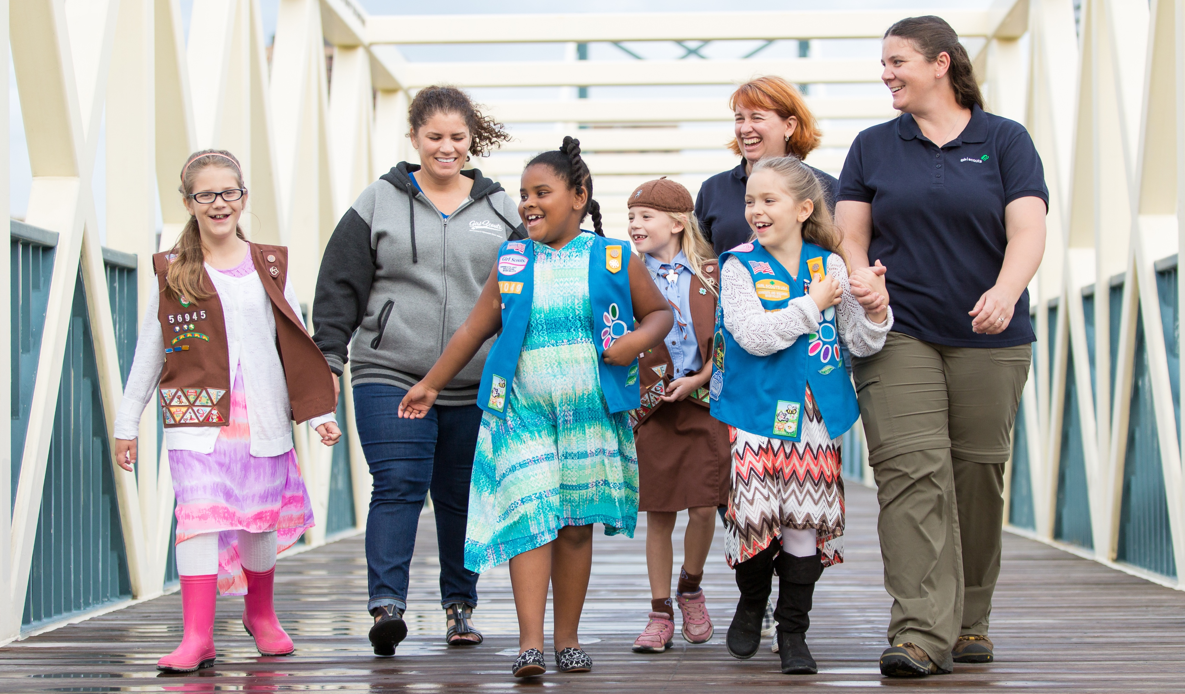
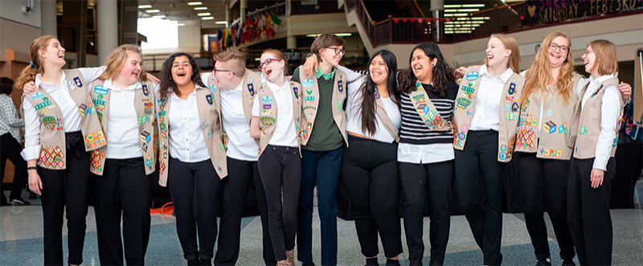
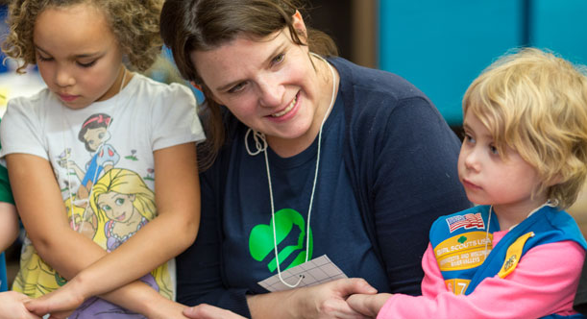
WELCOME
Girl Scouts is the place for every girl.
Notes:
Resting slide
Welcome, introductions, and set meeting agenda
Thank everyone, then introduce yourself and volunteers

Slide 2
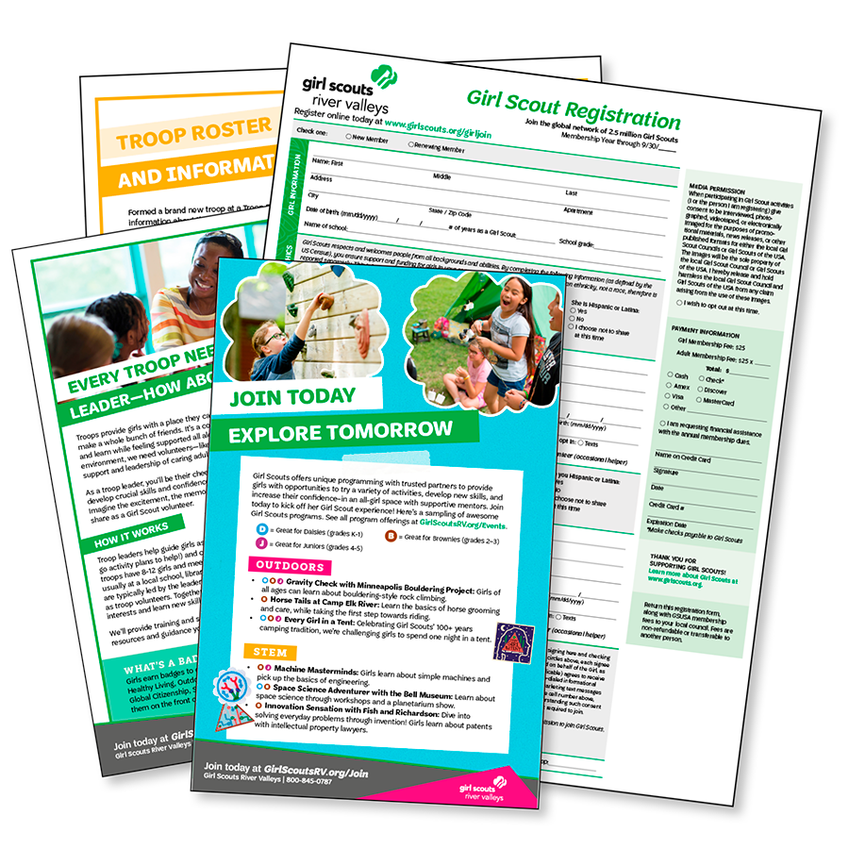
AGENDA
Check-in
Program Overview
Girl Activity
Register & Form Troops
Wrap Up & Questions
Volunteers are needed to form troops!
Notes:
Welcome, introductions, and set meeting agenda
Give a brief overview of the agenda
“We’ll be taking the next___ minutes to provide you more info about Girl Scouts, identify leaders and volunteers, then help you register and form troops!”
Clarify purpose and set expectations
“Tonight, we want to help you decide if Girl Scouts is a good fit and form new troops—each troop needs at least one adult to volunteer as leader.”
Address the possible interest around being a leader, watch for reactions
Excited and ready to lead their girl’s troop
Interested but have questions
Some may decide to do what we call a ‘team-led’ troop where all parents register as volunteers and take turns facilitating troop meetings
Prepare them for what the outcome could look like if no leaders step forward
“…we can still get your girl signed up and placed on our waiting list—River Valleys will work to identify a troop for your girl to join in the area which could take a month or longer, or she could choose to participate as an individual Girl Scout, called a Juliette.”
Dedicate time to interested families by creating an environment where it’s okay to say no.
“If you decide at the end of the evening that it isn’t a good fit – or isn’t going to work for your family right now – that’s totally okay! Please take my contact information and feel free to reach out if you have interest down the road.”

Slide 3
What brought you to this event?
We want to make sure all of your questions are answered!
Notes:
Check-in, testimonial(s), and girl video
Find out what matters to families first... then share based on what they care about

Slide 4
PROGRAM IMPACT
Hear from members in the room about their experiences in the program!
Notes:
Check-in, testimonial(s), and girl video
Current Girl Scouts and volunteers helping at your event can talk about why they’re proud to be a Girl Scout—you should too!
Have them share popcorn style
“What brought you to the event today?”
Ask for a show of hands
“Has anyone already started the process of joining?”
Advance to the video. Here’s the link if it doesn’t play: https://youtu.be/WU8o8JNg6yU

Slide 5
Notes:
https://youtu.be/WU8o8JNg6yU
Ask girls what activities shown in the video they’d like to do!

Slide 6
Let’s share!
Girls! What
activity looked most exciting to you?
Notes:
Ask girls what activities from the video they'd be interested in doing!

Slide 7
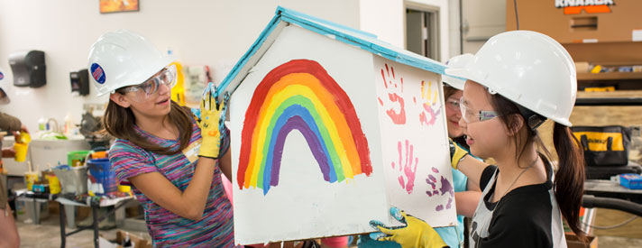
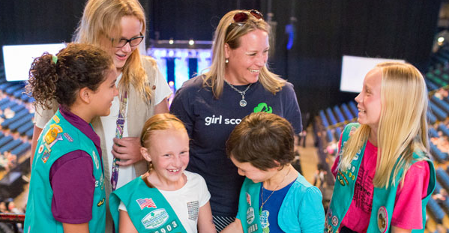
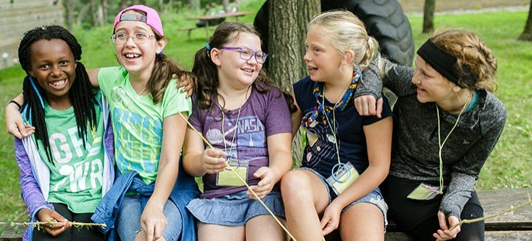
ACTIVITY TIME!
Let’s try a hands-on Girl Scout activity
Notes:
Transition to girl activity
Plan a couple questions based on whether you used the video or did testimonials (or both)
After you ask your questions, have the girls follow your volunteer to the girl activity area
Create interest for girls about joining while allowing families to see the Girl Scout mission in action by asking your question
“Girls, which activity looked most exciting to you?”
“Girls, which story from our current Girl Scouts sounded like something you could see yourself doing?”
“Girls, which program described by our volunteers sounded like one you’d love to try?”

Slide 8
Questions?
What information
do you need to make a decision about your girl joining
Girl Scouts?
What questions do you have about becoming a troop leader?
Notes:
Family Girl Scout presentation
Speak to what matters to your audience—start with Q&A—it’s okay if you don’t have all the answers!
General information about Girl Scouts and what troops do
What it means to be a troop leader
Avoid reading off a page—have a conversation with the room!
Don’t forget to check out the ‘How to Talk to Prospective Families and Volunteers’ resource on the recruiter webpage before your event.

Slide 9
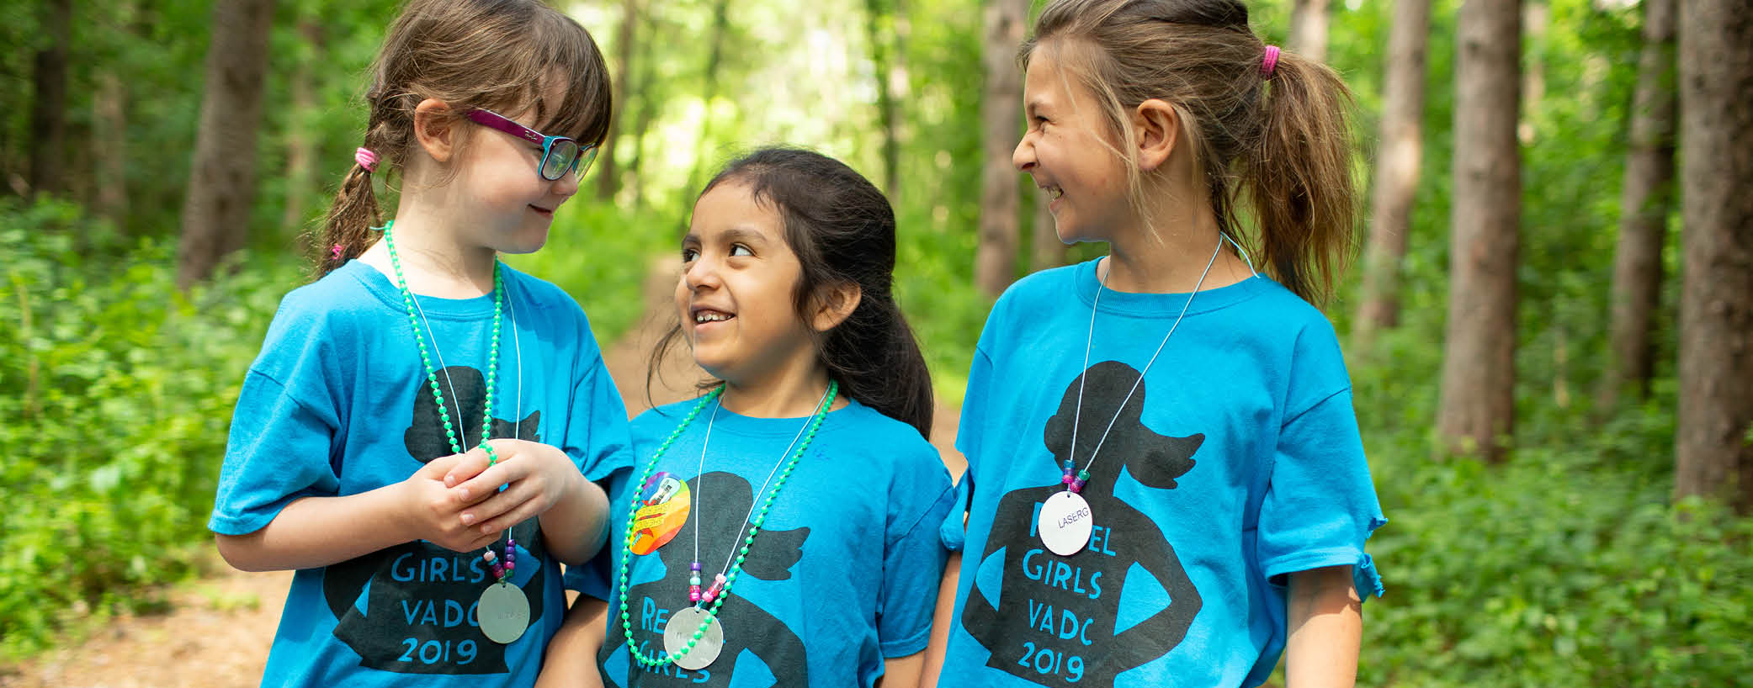
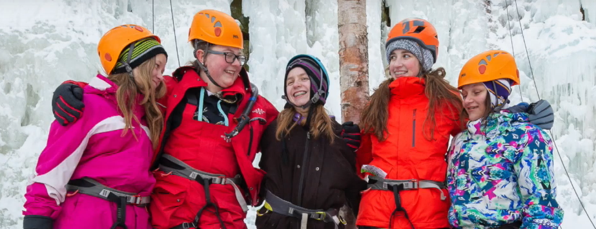
What is the girl scout leadership experience?
Girl Scouts offers hands-on leadership programming in the areas of:
Science, technology, engineering, & math (STEM)
Outdoors
Life Skills
Entrepreneurship
All badges, camps, and Girl Scout events are based on these core program areas.
Notes:
Family Girl Scout presentation
Your experience as a volunteer is a great way to inform your answers, but a couple essential topics you may want to touch on include…
What is GSLE?
Our program centers on what we call the Girl Scout Leadership Experience, or GSLE.
At Girl Scouts, she’ll get to lead her own adventure and team up with other girls in an all-girl environment to choose the exciting, hands-on activities that interest her most.
This is all done through engaging, challenging, and fun activities like:
earning badges
going on awesome trips
selling cookies
exploring science
getting outdoors
doing community service projects

Slide 10
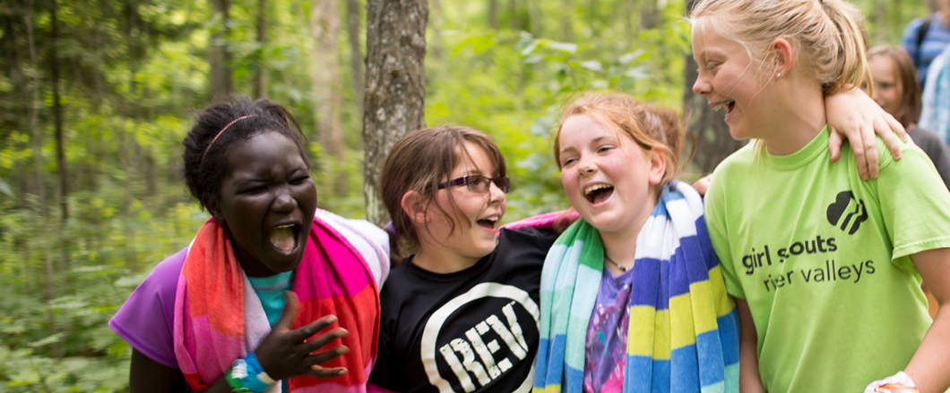
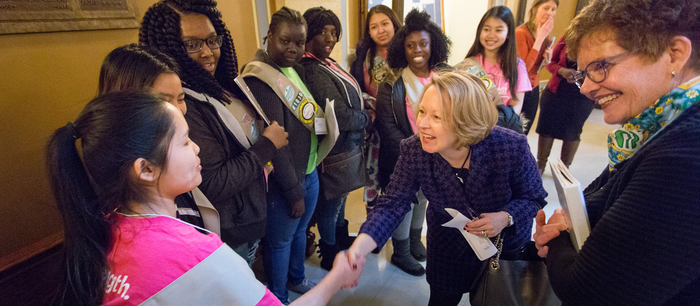
What will she gain?
A lifetime of leadership!
As a Girl Scout, she will:
Develop a strong sense of self
Display positive values
Seek challenges and learn from setbacks
Form and maintain healthy relationships
Learn to identify and solve problems in her community
Notes:
Family Girl Scout presentation
What does she gain?
A lifetime of leadership! Being a Girl Scout helps girls thrive in give key ways.
She will get to develop a strong sense of self,
display positive values,
seek challenges and learn from setbacks,
form and maintain healthy relationships, and
Learn to identify and solve problems in her community

Slide 11
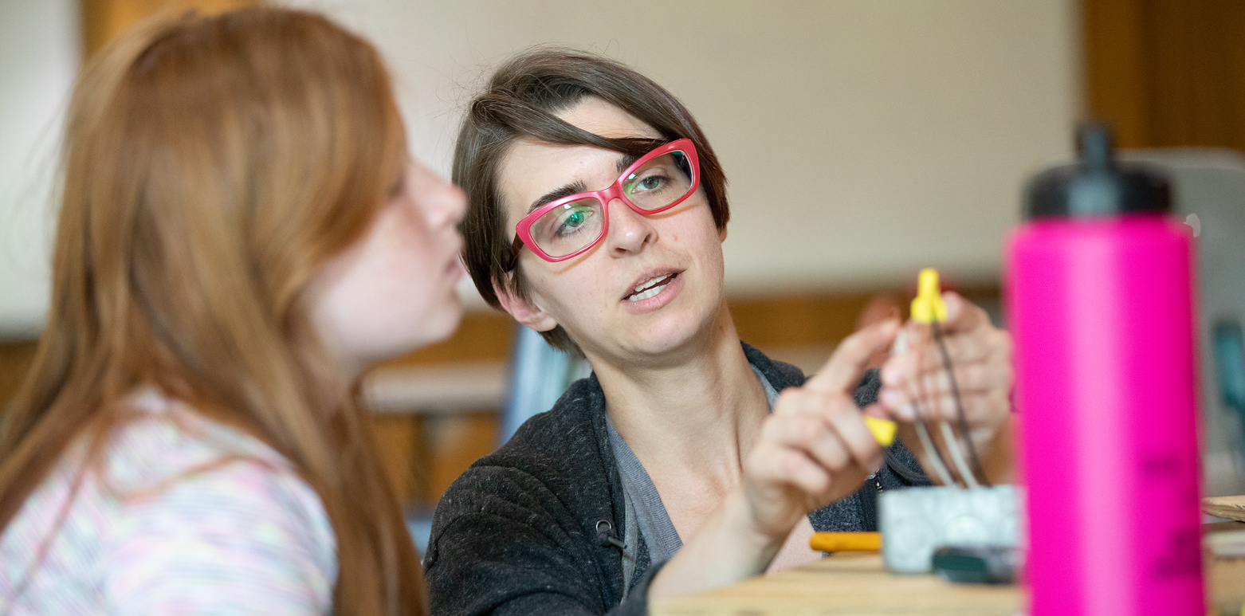
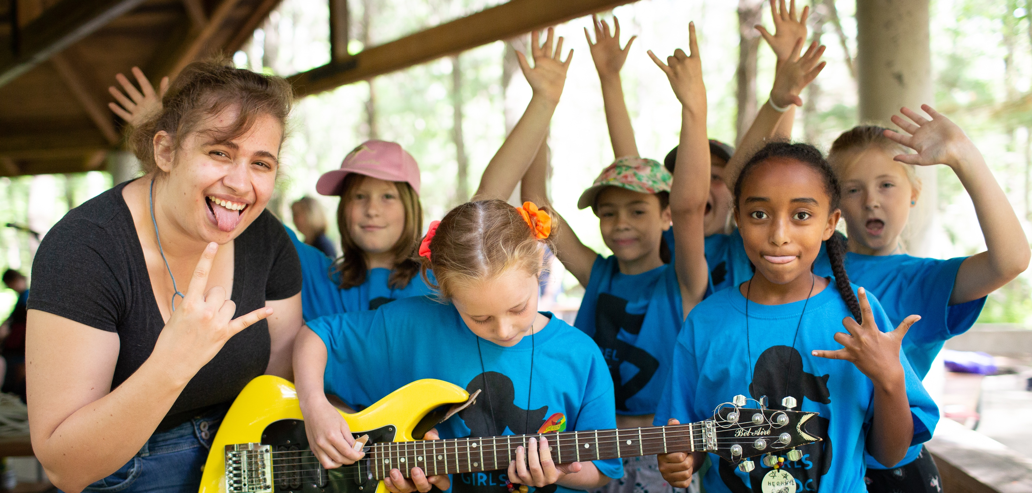
What does a troop leader do?
You’ll guide a group of girls and mentor them as they make new friends, practice leadership, and so much more!
All troop leaders and volunteers must pass background checks to be eligible.
Girl safety is our top priority!
Girl Scouts River Valleys provides new troop leader trainings & resources to get you started!
Notes:
Family Girl Scout presentation
What does a troop leader do?
As a troop leader, you guide a group of girls—a “troop”—and mentor them as they make new friends, practice a lifetime of leadership with girl-led activities, and so much more!
You will be part of a network of thousands of talented volunteers just like you.
We have a resource website for registered volunteers with training, planning guides, activity plans, field trip opportunities, forms, role descriptions, and more.
You’ll also have access to Girl Scout staff who are dedicated to helping you succeed.

Slide 12
Membership basics
UNIFORMS:
My Girl Scout Kits
Available at our shops
Purchased individually
(Future troop funds may cover new uniforms and badges)
COOKIE SALE:
Optional
Troop money-earning
Supports activities chosen by the troop
TROOP MEETINGS:
Typically twice a month (badge-earning meeting, field trip/event)
Notes:
Cover these basic membership facts most families are interested in.

Slide 13
Forming troops
Get to know your new troop! Say your name, age/school,
and one thing that excites you about Girl Scouts!
Notes:
Group families based on school or grade level
Tell adults and girls when it is time to regroup, and how to find a table
Use table tents to indicate table groupings
Encourage rapport building among families by getting them to talk to each other
Let families know their table may be their potential troop
Did their girls get a chance to meet during the activity?
Have they discussed who may be interested in volunteering?
------------------------------------
Make the volunteer ask
Inviting adults to volunteer is giving them an awesome opportunity, don’t be afraid to ask if they’re ready to join and be a troop leader—maybe they just have more questions or be waiting on you to help them ‘form’ their troop
“Are you ready to register as a troop leader? What other questions can I answer for you?”
Bring up the team-led option if you find the adults are reluctant, unable to commit, or mention being too busy to lead a troop
“Often in these situations, we recommend forming a team-led troop… We would still need one parent to be listed as the official troop leader, but they take on more of an administrative role – communicating meeting schedules, welcoming new girls to the troop, or registering the troop for an event. If this option sounds good to you all, we can determine what roles everyone would like to play in the troop’s leadership”
If using the Recruitment Event PowerPoint, leave on slide 11.
------------------------------------
Register girls and volunteers as new Girl Scout members
If girls are registering but no leader steps forward, remind adults of the team-led option as a way for their girl to get started now, instead of being placed on a waiting list..
“A lot of families enjoy this team-led approach, it gives all parents an opportunity to be involved in their girls’ troop, and the time commitment needed from each person is lower.”

Slide 14
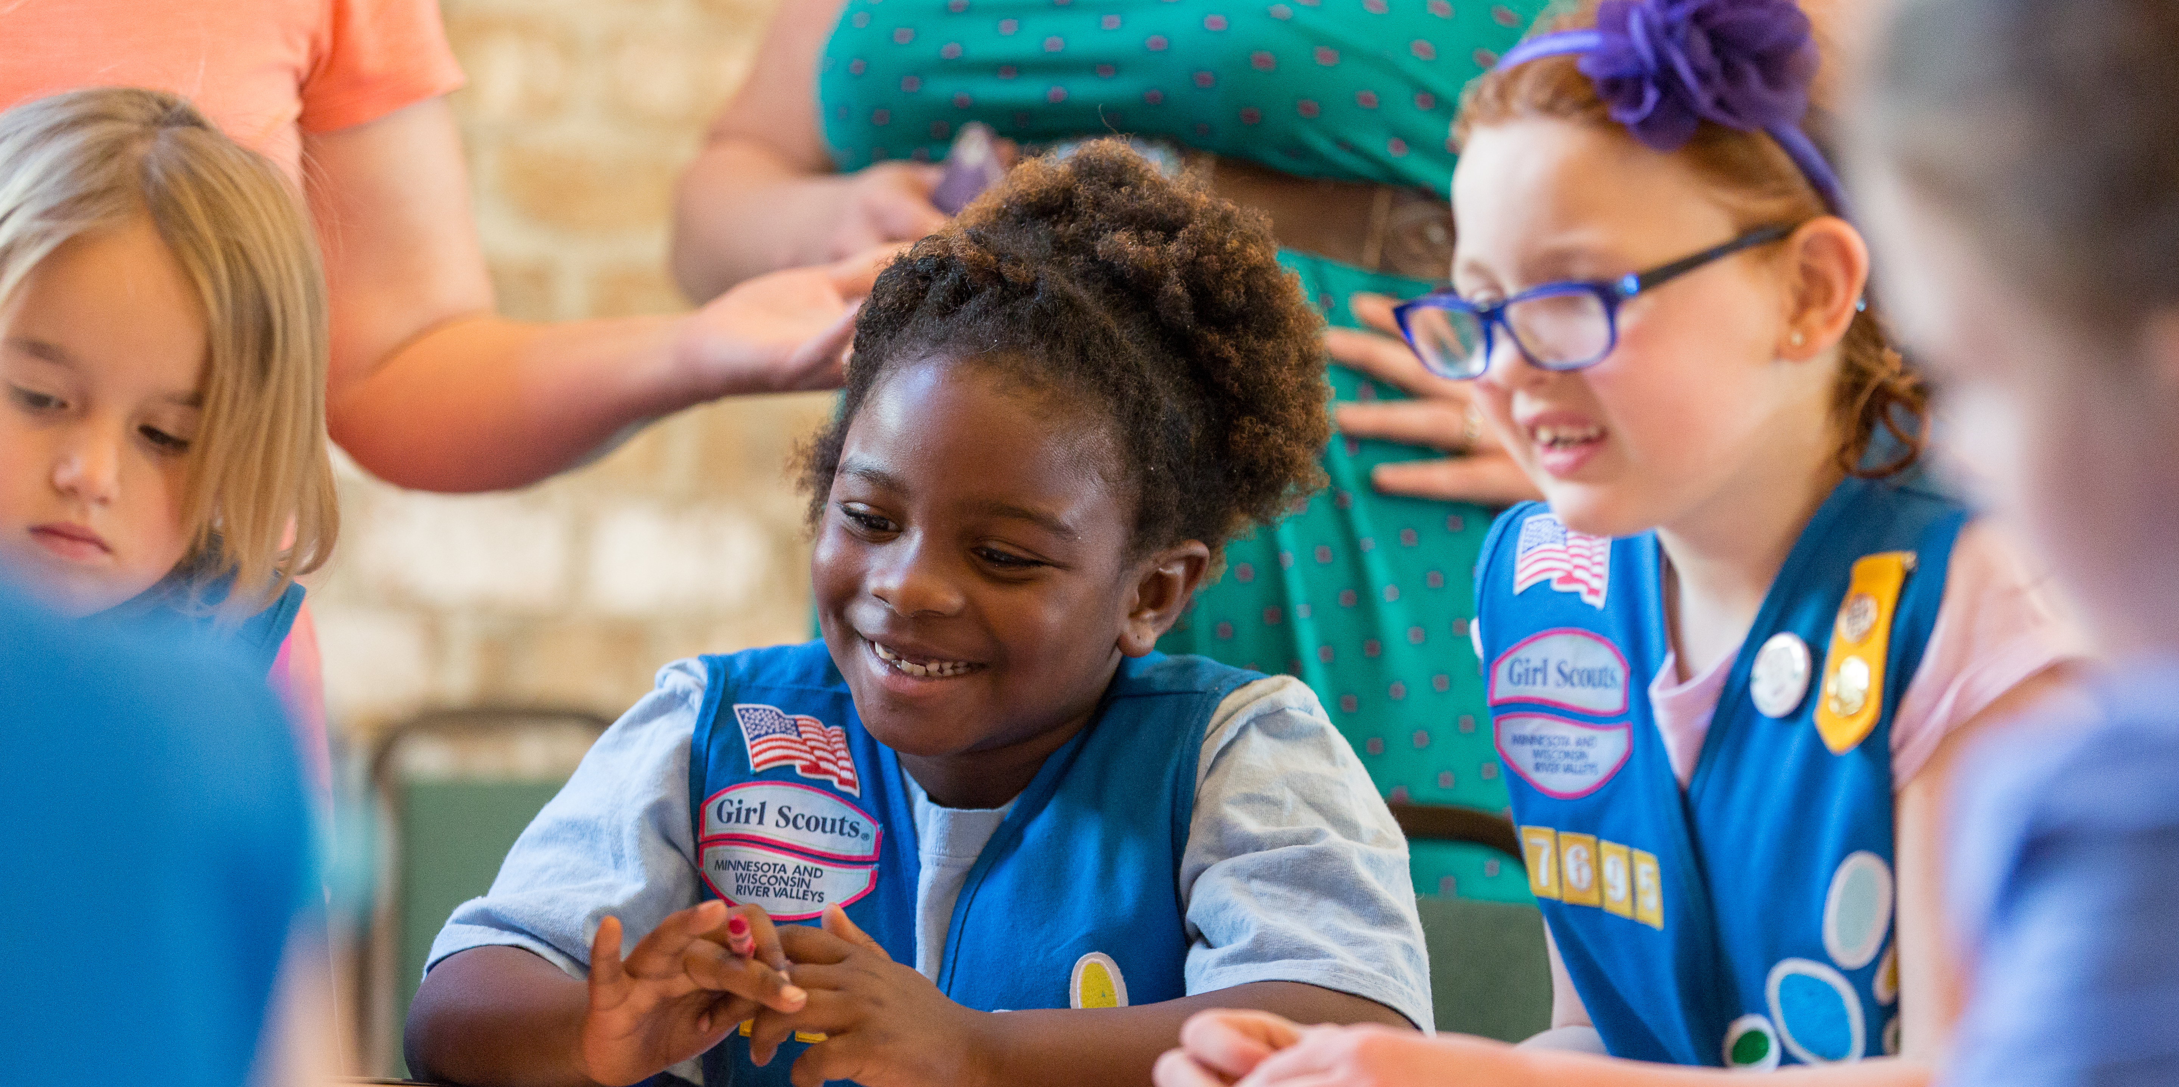
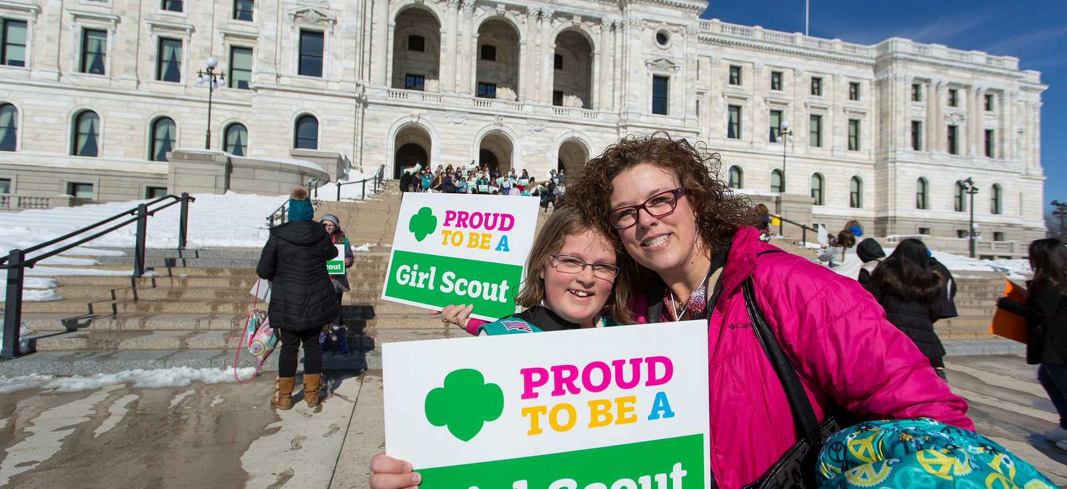
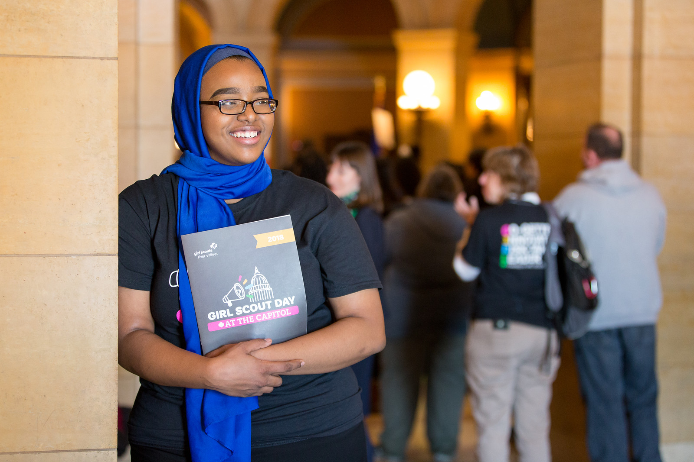
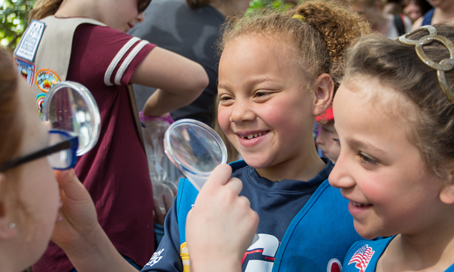
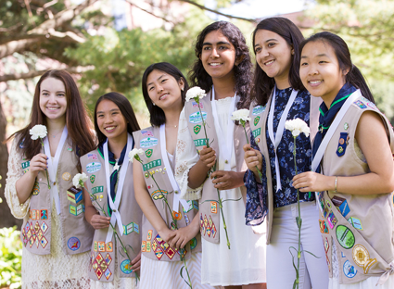
THANK YOU!
Notes:
Closing and thank you
Next steps can vary greatly depending on the status of the troop, if a leader has been identified, etc. Covering these aspects of next steps helps to solidify expectations and make sure everyone is clear about the plan ahead
Timeline – when can they expect follow up?
What they need to do next (for example, troop leaders complete a background check)

