Slide 1
BROWNIE MY FAMILY STORY BADGE VIRTUAL MEETING PLAN
Overview
This slide deck walks you through activities to complete all or most steps of a badge. It includes a variety of interactive activities that you can do as a troop – including video, group conversations, hands-on activities, and more. Review the full deck and notes section prior to your meeting for tips and suggestions. In addition, these first slides will outline the general meeting plan.
Depending on the length of your virtual meetings, you may choose to complete this badge over the course of 1-2 meetings. Connect with families ahead of time to let them know what materials they should have ready prior to logging in. Badges can be purchased by the troop for family in the online shop.
Materials Needed
Paper
Writing utensils
Recipe card template
Family special object
For 2D Family Tree: Paper or family tree template
For 3D Family Tree: Branch, construction paper, hole punch, string
Notes:
Overview for the troop leader

Slide 2
Brownie My Family Story Badge Virtual Meeting Overview
Activity | Slide Number | Time | Notes
Intro/Promise & Law | Slide 3 – 5 | 5 min
Icebreaker | Slide 6 | 5 min
Who’s in Your Family? | Slide 7 | 5 min
Read Todd Parr’s The Family Book | Slide 8 | 5 min
Family Tree/Picture | Slides 9 – 12 | 10 min | Pick one activity from slides 10 – 12 to complete with your girls. Draw your own family tree/picture to share with girls prior to the meeting.
Family Recipes | Slide 13 – 14 | 10 min | Send the recipe card template to families to print out and complete before the meeting.
Family Object Show & Tell | Slide 15 | 10 min | Have girls bring a special family object to the meeting to share with the group.
Write to a Family Member | Slide 16 | 5 min | Depending on time, girls can complete this step on their own or during the meeting.
Closing | Slide 17 – 18 | 5 min
Notes:
Overview for the troop leader

Slide 3
Brownie My Family Story Badge
Girl Scouts River Valleys
Notes:
Brownie My Family Story Badge
Step 1: Explore family stories
Step 2: Know where your family is from
Step 3: Make a story tree
Step 4: Find an object that means something to your family
Step 5: Share your family story

Slide 4
SAY THE
GIRL SCOUT PROMISE
On my honor, I will try:
To serve God* and my country,
To help people at all times,
And to live by the Girl Scout Law.
*Members may substitute for the word God in accordance with their own spiritual beliefs.​
Notes:
Open your meeting with the Girl Scout Promise and Law.​

Slide 5
I will do my best to be
honest and fair,
friendly and helpful,
considerate and caring,
courageous and strong, and
responsible for what I say and do,
And to
respect myself and others,
respect authority,
use resources wisely,
make the world a better place, and
be a sister to every Girl Scout.
SAY THE
GIRL SCOUT LAW
Notes:
Open your meeting with the Girl Scout Promise and Law.​

Slide 6
ICE BREAKER
If you could be invisible for one day, what would you do?
Notes:
Ice breaker question

Slide 7
WHO'S IN YOUR FAMILY?
THERE ARE ALL KINDS OF FAMILIES!
Each family is special in its own way.
Tell us about your family
Who do you live with?
Do you have any siblings? How many?
Do you have any pets?
What do you like to do together as a family?
Notes:
Step 1: Explore family stories
Step 2: Know where your family is from
Step 5: Share your family story
Tell girls a little bit about your own family. Then ask girls to tell each other about their families.

Slide 8
READ TODD PARR’S THE FAMILY BOOK
Notes:
Step 1: Explore family stories
Watch a reading of Todd Parr’s The Family Book to explore many different kinds of families:
https://youtu.be/AyVL9bH0guk

Slide 9
WHAT'S A FAMILY TREE?
Your family tree is made up of everyone in your family.
Knowing who your family members are is only half the fun—find a special detail about each person and include that in your family tree.
Notes:
Step 2: Know where your family is from
Step 3: Make a story tree
For this step, you’ll be creating family trees/family pictures with your girls. Prior to the meeting, complete your family tree/family picture to share with your troop.
Choose one activity option from Slides 9 – 12, then delete the slides you aren’t using.

Slide 10
LET'S MAKE A FAMILY TREE!
Use this example as a guide, or make up your own. Be creative!
Notes:
2D Family Tree: If you choose this activity, delete slides 11 and 12.
Step 2: Know where your family is from
Step 3: Make a story tree
PREP:
If you’d like girls to use this template, send out a link to families and have them print out a copy for their girl to bring to the meeting. (Find the template here: https://freefamilytreetemplates.com/family-tree-for-children/)
MATERIALS:
Template (or blank paper)
Writing utensil

Slide 11
LET'S MAKE A FAMILY TREE!
Use construction paper to cut out leaves
Write down the names of your family members on the leaf
Write the special detail about them on the back
Hole punch your leaves
Tie the leaf to the branch
Notes:
3D Family Tree: If you choose this activity, delete slides 10 and 12.
Step 2: Know where your family is from
Step 3: Make a story tree
PREP:
Ask girls to find a branch outside and bring to this meeting.
MATERIALS:
Bring construction paper, writing utensils, a hole punch, and string.

Slide 12
WHAT DOES YOUR FAMILY LOOK LIKE?
Family isn't just who you're related to! Family can mean different things for different people.
Draw a picture to show us what your family is like!
Notes:
Family Picture: If you choose this activity, delete slides 9-11.
Step 2: Know where your family is from
Step 3: Make a story tree
Troop leaders: For many different reasons, some girls may not be able to complete a family tree. If you know that some girls in your troop will be sensitive to filling out a family tree, substitute the family tree activity with this one instead.
MATERIALS:
Paper and writing/coloring utensils

Slide 13
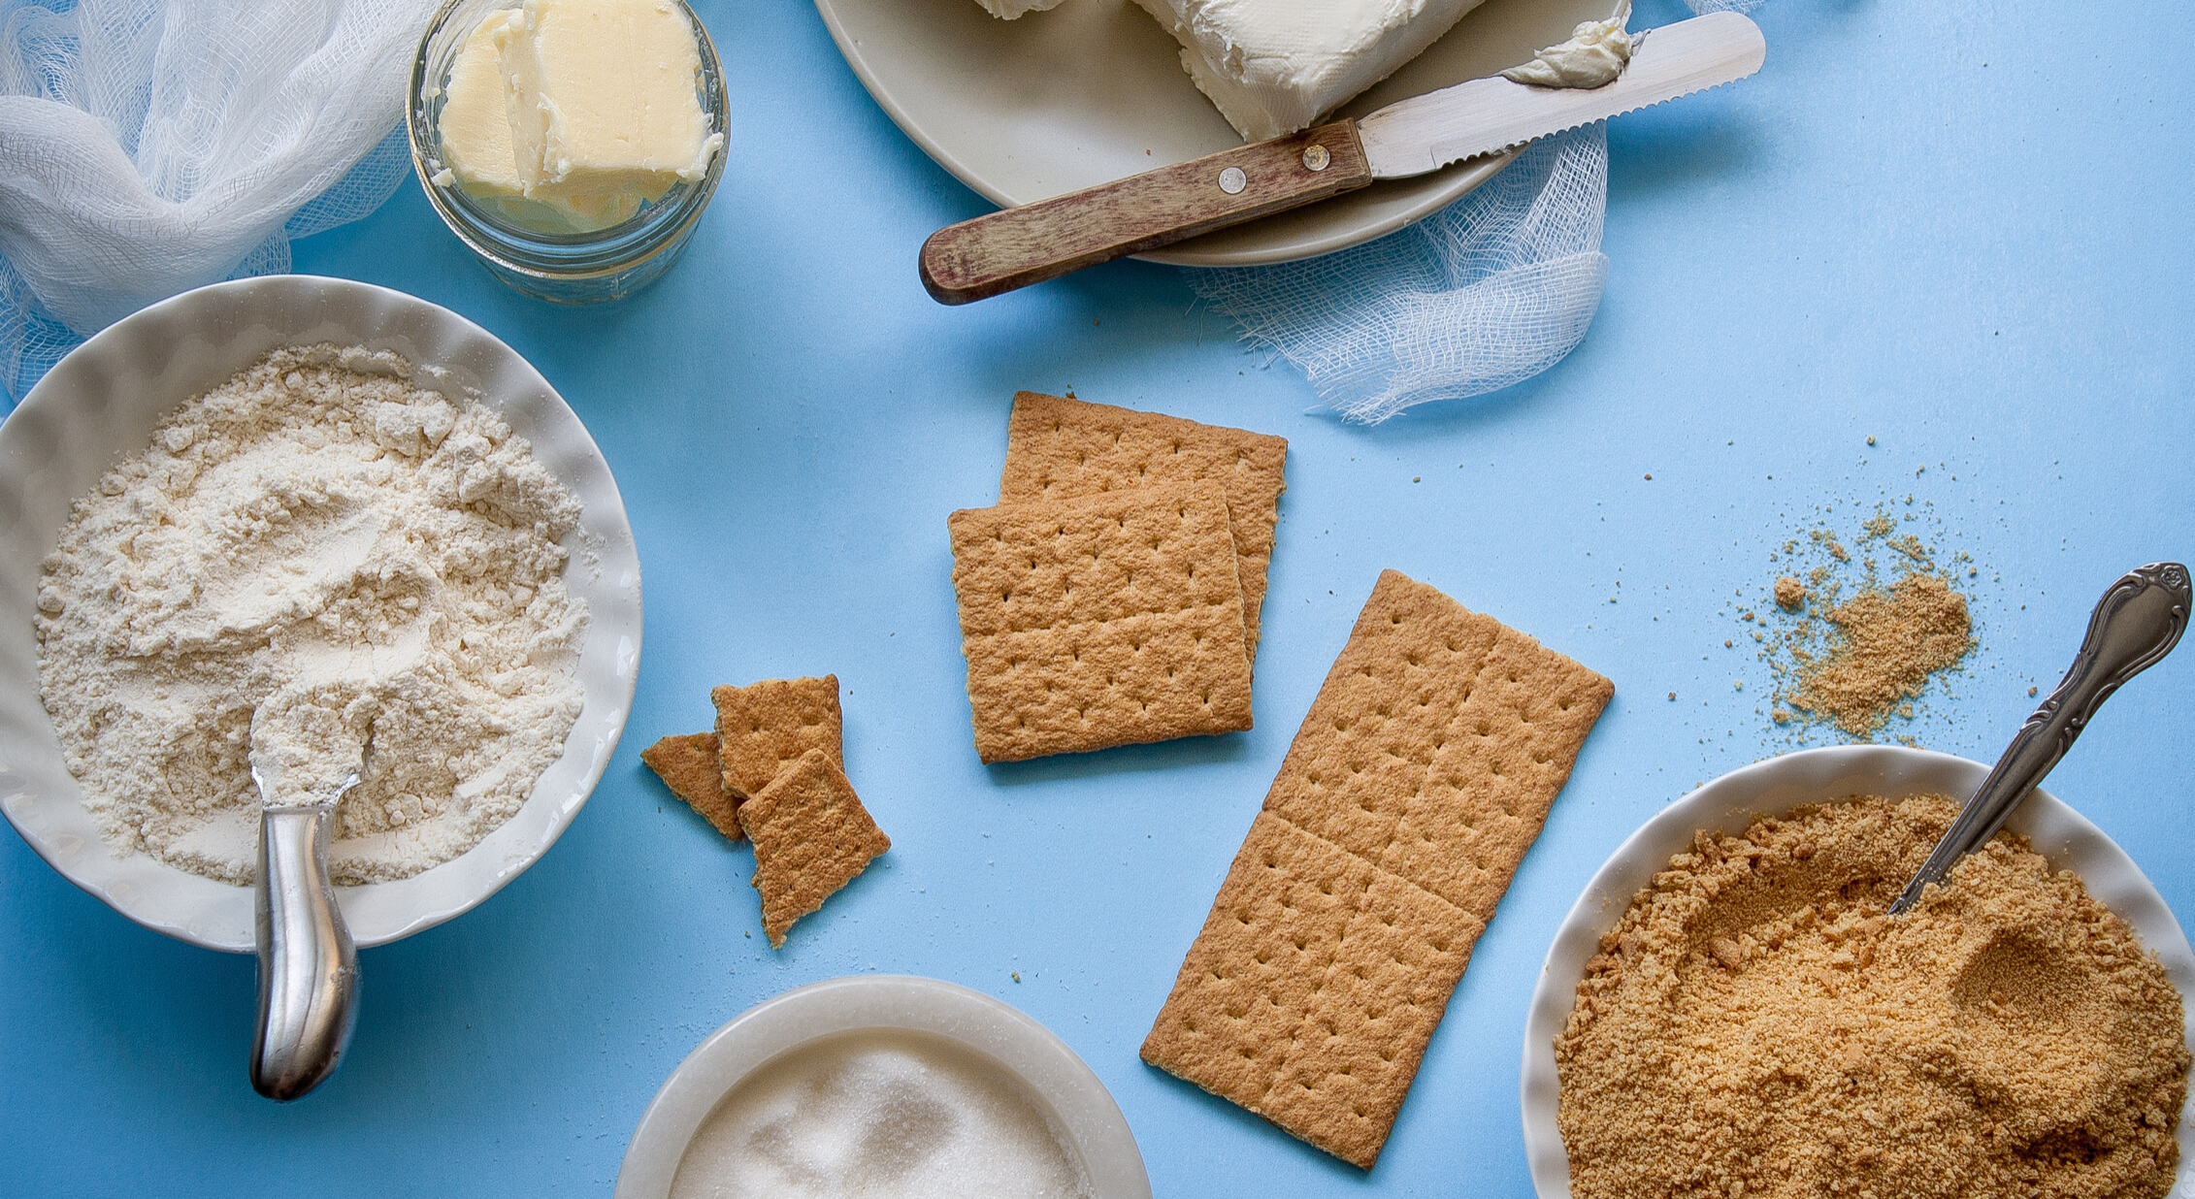
FAMILY RECIPES
Many families enjoy cooking and baking together. Families often celebrate special occasions with a certain kind of food. Does your family have a family recipe for a food you all enjoy eating?
Notes:
Step 1: Explore family stories
Step 5: Share your family story
Prior to the meeting, fill out your own family recipe card to share with your troop. Share the history behind this recipe—where did you get it from? Who taught you how to cook it? What’s your favorite memory associated with this food?
PREP:
Send templates to families to help their girls complete the recipe card. (Find the template here: https://www.basicinvite.com/vintage-recipe-cards.html)
MATERIALS:
Printed recipe cards
Writing utensils

Slide 14
SHARE YOUR FAMILY RECIPE
EVERY FAMILY HAS A SPECIAL FOOD!
Tell us about your family recipe
Who gave you this recipe?
Do you eat it as part of a special occasion?
What's the best part about the recipe? Eating it? Making it?
Notes:
Step 1: Explore family stories
Step 5: Share your family story
You can copy and paste the questions into the chat box and then stop sharing your screen so that girls can see each other better while they share their family recipes.

Slide 15
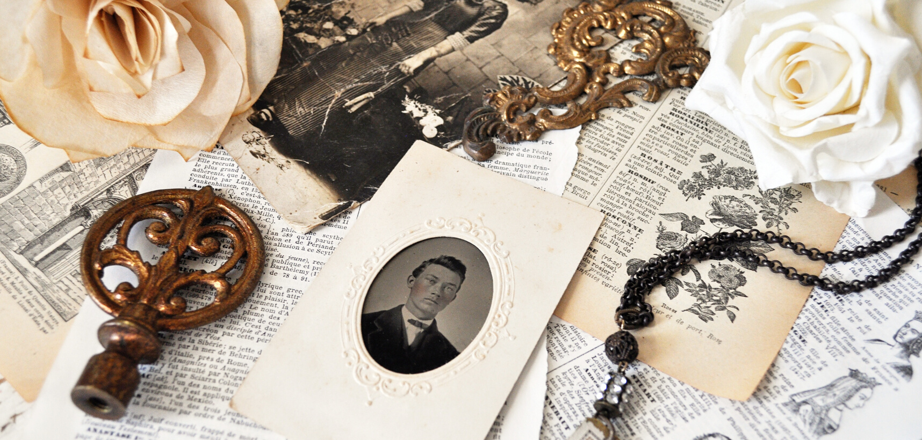
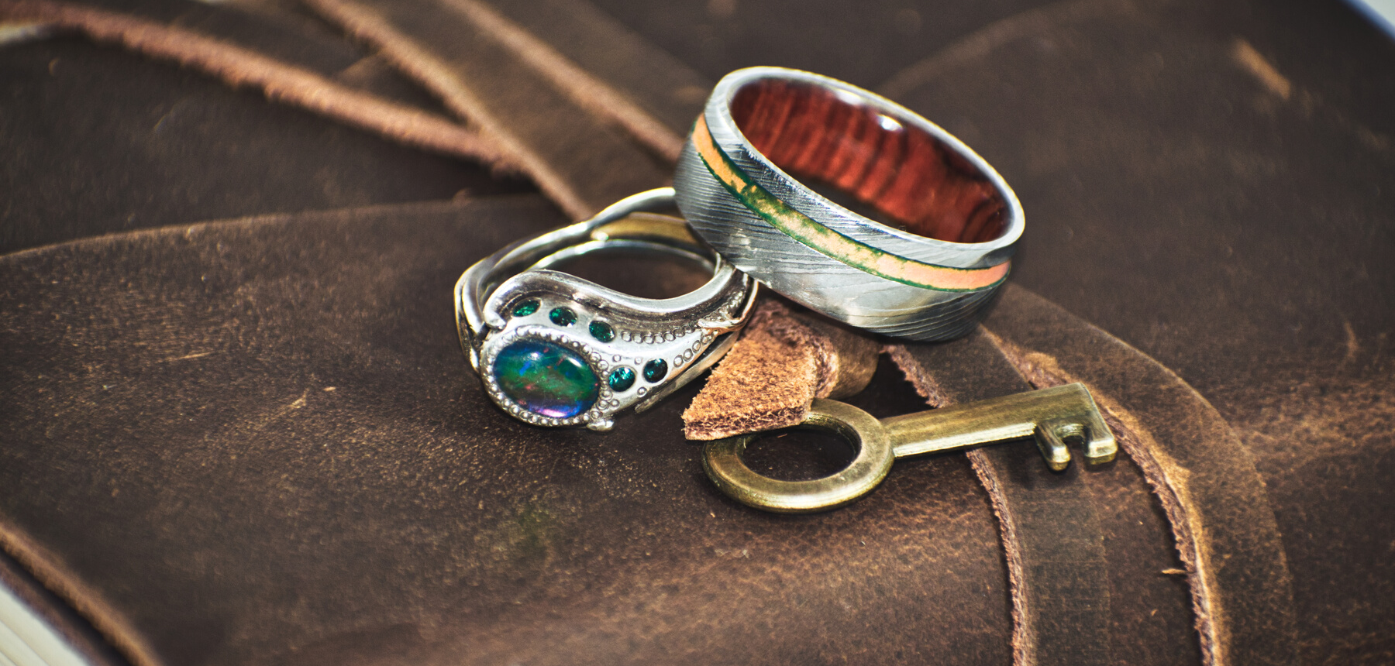
FAMILY OBJECT
SHOW & TELL
What object did you find that's special to your family?
Share it with us!
Notes:
Step 4: Find an object that means something to your family
Prior to the meeting, ask girls and families to find an old photo or special object that says something about their family. Girls should come prepared with a little bit of history about that particular picture or object (Who’s in the photo, when was it taken, who did this object belong and how did it get to your family, etc.)
You can copy and paste the questions into the chat box and then stop sharing your screen so that girls can see each other better while they share their family recipes.

Slide 16
WRITE TO A FAMILY MEMBER!
Can you think of a family member who doesn't live with you who might enjoy hearing from you?
You learned so much about your family today!
Write a letter to them!
Notes:
Step 1: Explore family stories
Step 5: Share your family story
Note: This can be assigned as activity for girls to do on their own if you don’t have time for girls to write their letters during the meeting. Writing to their family member is a step girls will have to complete in order to earn their badge.
MATERIALS:
Paper
Envelope and stamp
Writing utensil

Slide 17
I've got something in my pocket, it belongs across my face.
I keep it very close at hand, in a most convienient place.
I'm sure you couldn't guess it if you guessed a long, long while.
So I'll take it out and put it on, it's a Great Big Brownie Smile!
LET'S SING THE BROWNIE SMILE SONG!
Notes:
If you need the melody for the Brownie Smile Song
https://youtu.be/apiYqXuktp4

Slide 18
You've earned the My Family Story Badge! See you next time, friends!
Notes:
Brownie My Family Story Badge
Step 1: Explore family stories
Step 2: Know where your family is from
Step 3: Make a story tree
Step 4: Find an object that means something to your family
Step 5: Share your family story

