Slide 2
Who can travel?
Any registered Girl Scout can travel.
Trips should be age appropriate.
Girl ability should be considered for all trips.

Slide 3
What is travel?
Any time girls leave their designated meeting space, it is considered travel.

Slide 4
Why travel?
Gain Skills
See new places and meet new people
Discover the world around them
Keep girls coming back

Slide 5
How: Girl-Led
Girls should have a part in the planning of all aspects of a trip
Where?
How?
What?
Age Appropriate

Slide 6
Types of Trips
Girls should have a part in the planning of all aspects of a trip
Where?
How?
What?
Age Appropriate
Consider:
Meeting Time
Day
Simple Overnight
Extended Overnight
International

Slide 7
Other travel opportunities
Destinations
Individual girl travel
5th grade and up
Application required
Getaways
Travel packages for troops
River Valleys Travel
2019 Belize: Wildlife Adventure

Slide 8
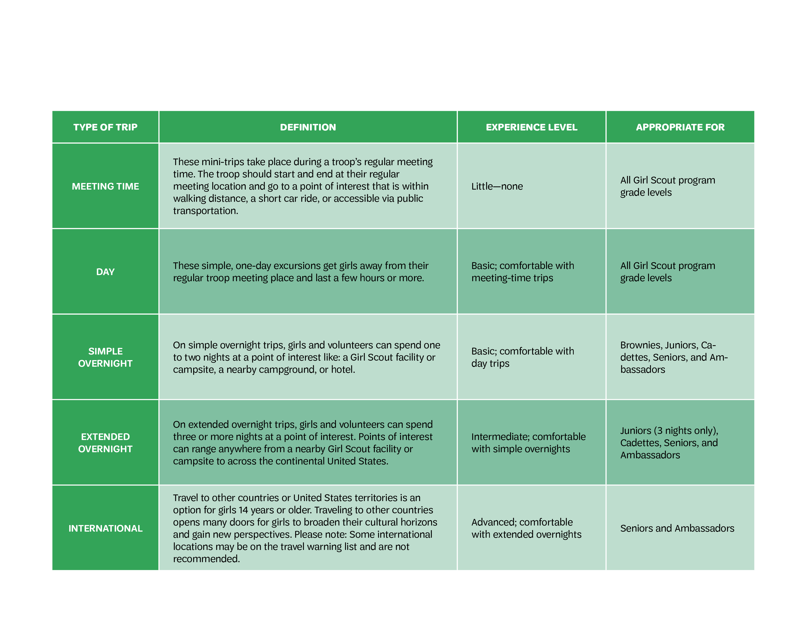
Travel Progression

Slide 9
Trip/Travel Planning Worksheet
Must be completed for all trips
Keep a copy for your records and give a copy to your emergency contact
A copy should be submitted to Girl Scouts River Valleys for Approval for Extended Trips, International Trips, and High Risk Activities 2 months prior to departure

Slide 10
Request to Travel – Extended Trips Form
Required for Extended and International Trips
Should be completed prior to the bulk of planning
Submit to Girl Scouts River Valleys at least 6 months prior to departure

Slide 11
Resources
Volunteers.GirlScoutsRV.org

Slide 12
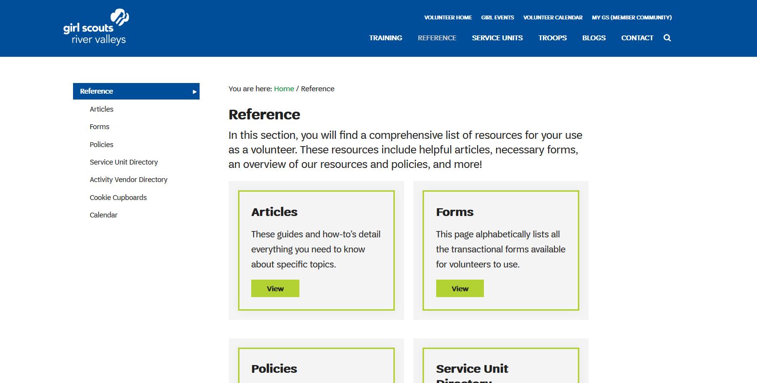
Resources – Travel Progression & Planning

Slide 13
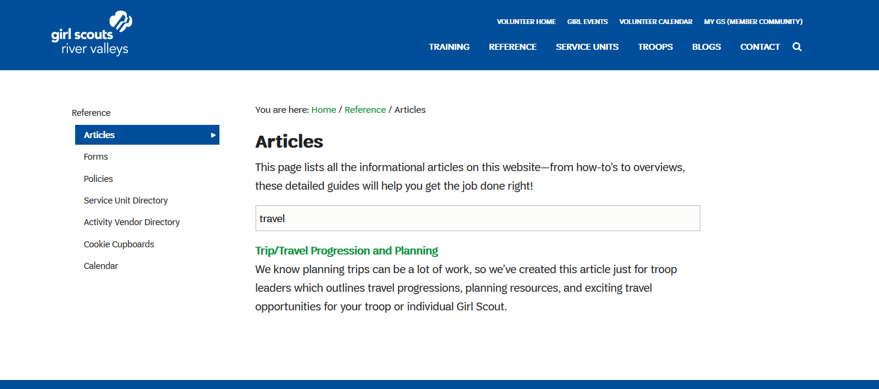
Resources – Travel Progression & Planning

Slide 14
Resources – Travel Progression & Planning

Slide 15
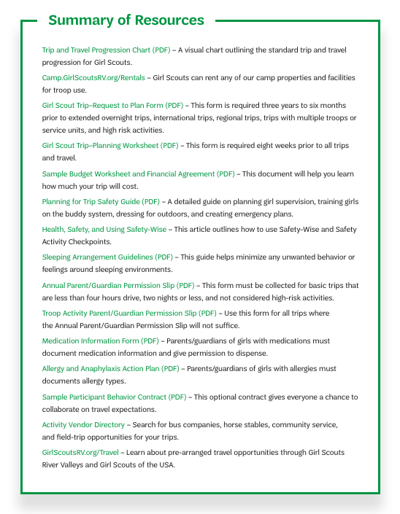
Other Resources

Slide 16
Questions?
Contact River Valleys at:
800-845-0787
or
girlscouts@girlscoutsrv.org

